Slide 1
Lecture 15 – Flowchart Methodologies
Notes:
Flowcharting is a simple tool and yet very powerful for understanding the behavior of complex systems. In past decades, flowcharting was often first thing taught in programming classes, but today it is rarely taught. Flowcharting sounds like a simple thing to do, but discovering the principles and variations in flowcharting techniques by yourself can be time consuming. The purpose of this lecture is to acquaint you with these techniques so you can rapidly use them without having to discover the principles on your own.

Slide 2
Outline
Traditional Algorithm and System FlowCharts
Data Flow Diagrams
System Flow Diagrams and Process Flows
State Diagrams
Shuttle Malfunction Procedures
Decision trees
System Modeling Tools - UML
Notes:
There are many different ways to use flowcharting methodologies and we’ll discuss them in this lecture showingthe difference in techniques and benefits.

Slide 3
FlowCharts
Flow charts show the process of algorithms by showing the sequence of operation and decisions using standard symbols
Developed by Herman Goldstine and John Von Neumann at Princeton in the 1940’s
Useful in sequential machines with single flow of control
  These types of computers are called “Von Neumann Machines”
Less useful in more modern computers with multiple parallel processes
Can be used to express flow of systems as well as algorithms

Slide 4
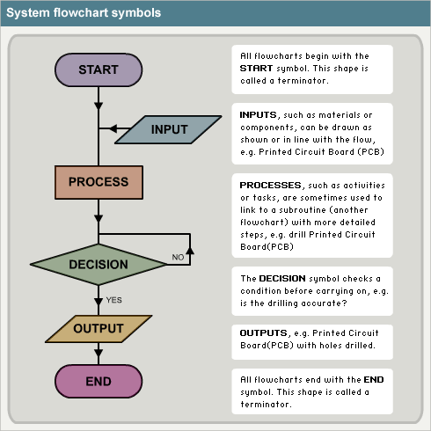
www.bbc.co.uk
To follow a flow chart
You start at start
You follow the arrows
Accomplish the actions within each shape
Pick a direction when you reach a diamond based on the question posed in the diamond
Stop when you hit the end
Notes:
This is about a basic a flow chart as you can have. First, there always is a start and an end state. Inputs are steps in which data is brought into an algorithm or computational process, process is a set of steps performed by the computer on input data, decision involves branching based on inputs or computations into different logic paths and output involves sending data out of the process.

Slide 5
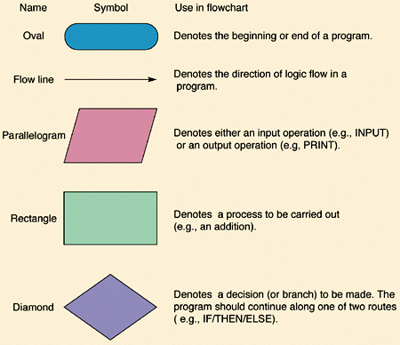
The basics
Notes:
These are the basic symbols. Any flowchart can be accomplished with these basic symbols alone.

Slide 6
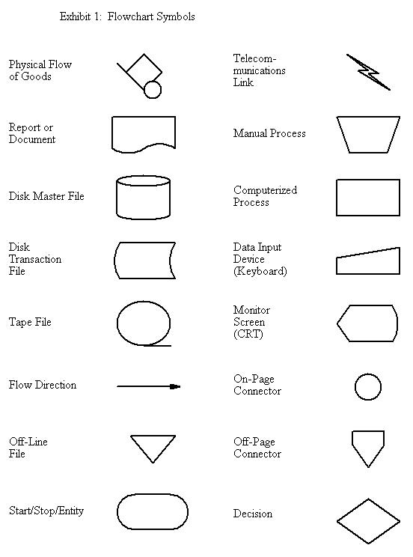
More Complicated – computer oriented
Notes:
These symbols are often used in data processing flowcharts and contain symbology unique to computer data processing. Some of these are being overtaken by technology – such as the magnetic tape file.

Slide 7
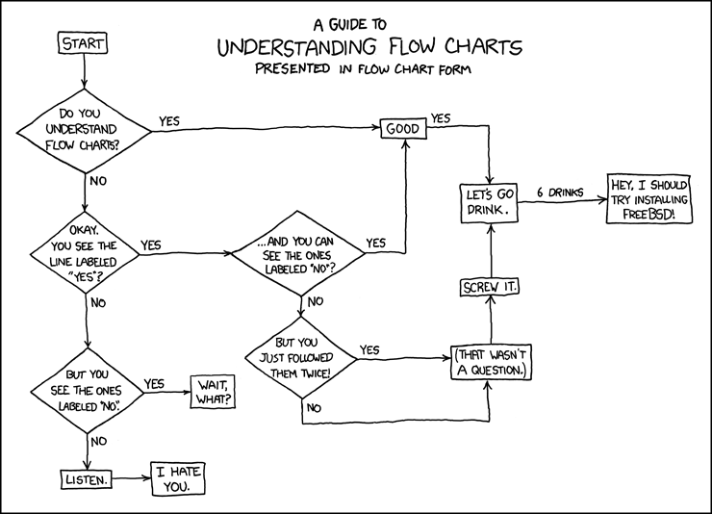
Courtesy of xkcd
1
3
2
Notes:
This cartoon is very funny – if you follow the flow chart by deciding yes in diamonds 1,2 and 3, it makes perfect sense and you end up in a bar having drinks (and then in a drunken state attempt a really complex software task in installing the freebsd linux operating system on your computer)
Blocks diamonds 4 and 5 make no sense no matter which way you decide… and that’s where the joke is
Or perhaps you have to be as big a geek as I am to enjoy it…..
4
5

Slide 8
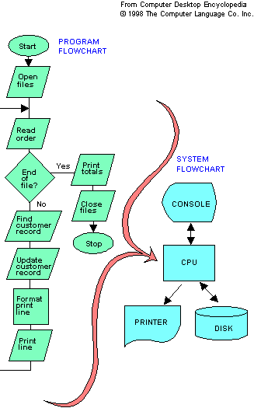
Shows the order of program execution
Shows the connection and flow of data within system elements
Difference between a program flowchart and a system flowchart
Notes:
This chart shows the difference between a flowchart – which shows the specific order of instruction execution in a computer program, and a system flowchart is that a systems flowchart shows the connection of elements and flow of data in a system while not being connected to the specific order in which operations are being conducted.

Slide 9
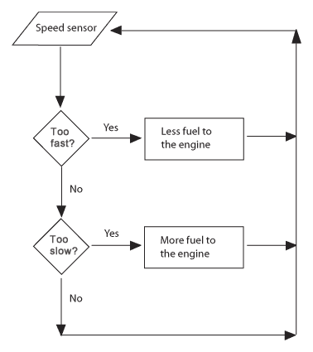
Generalizing a system through a flowchart – this could be an all analog implementation of control system or a software algorithm or even a completely mechanical system
Notes:
This chart shows how a systems function can be generalized through a flowchart. The flowchart presented here is for a fuel/speed control system for an engine. This could be implemented in a computer, but it also could be implemented through electrical circuits, electronic circuits, hydraulics, pneumatics or even a purely mechanical system. Any technology which checks speed against two limits and allows more or less fuel to the engine can be represented by this flow chart.
Even the operation of a Watts governor, the most simple control device and the basis of the industrial revolution, can be mopdeled by this type of flowchart.

Slide 10
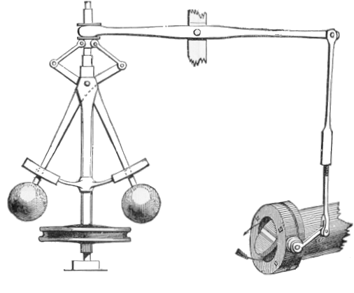
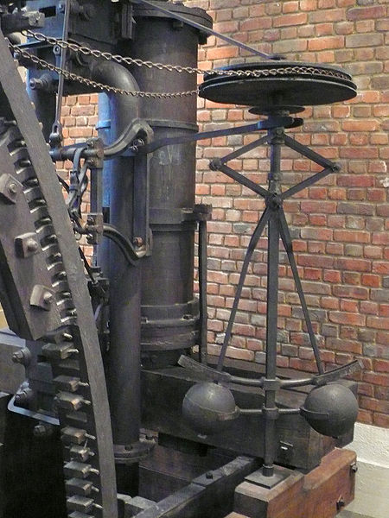
Watt Governor – The Mechanical Control System that led to the industrial revolution – can be described by the previous flowchart

Slide 11
Functional Flow Diagrams
A functional flow show the process of hardware through various stages
These are very useful for industrial process types of problems
Next chart shows the hardware flow of space shuttle components through Kennedy Space Center
These types of diagrams are important in planning and explaining the interaction of different components in a system and their relation to each other

Slide 13
Data Flow Diagrams
Defining Data Flow Diagrams (DFD)
  Graphical representation of a system’s data and how the processes transform the data is known as Data Flow Diagram (or DFD).
  Unlike, flowcharts, DFDs do not give detailed descriptions of modules but graphically describe a system’s data and how the data interact with the system.
DFDs are constructed using four major components
  external entries – e.g. sensors, keyboards
  data stores – e.g. disk, memory, cd
  processes – e.g. calibration, limit checking, computing averages
  data flows – how all of these are linked together
System Flow Diagrams and Data Flow Diagrams are very similar
  System Flow Diagrams tend to focus on connections and do not tend to discuss processes

Slide 14
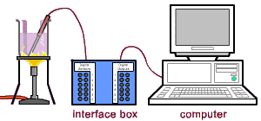
Example – Temperature Data Acquisition Problem
Temperature Sensor
Signal
Conditioning
Data Acquisition Unit (Analog to Digital Converter)
Processor
Display
Disk Storage
Audible Alarm

Slide 15
Algorithmic Flow Chart – Temperature Data Acquisition
Start
Acquire
Sensor
Data
Convert Raw
Data to
Calibrated
In Limits ?
Yes
Yes
Set Alarm=Off
No
Set Alarm=On
Log and Display
Results
Stop ?
Delay
40 ms
Stop
Notes:
The algorithmic flowchart shows the sequence of steps executed by the computer in order

Slide 16
Data Flow Diagram – Temperature Data Acquisition
Sensor
Signal
Conditioning
Analog To
Digital
Conversion
Calibration
In Limits ?
Alarm
Off
Alarm
On
Display
Raw
Value
Log
Raw
Value
Display
Calibrated
Value
Log
Calibrated
Value
Notes:
Thedata flow diagram shows how data flows in the system – from the sensor to logs and alarms

Slide 17
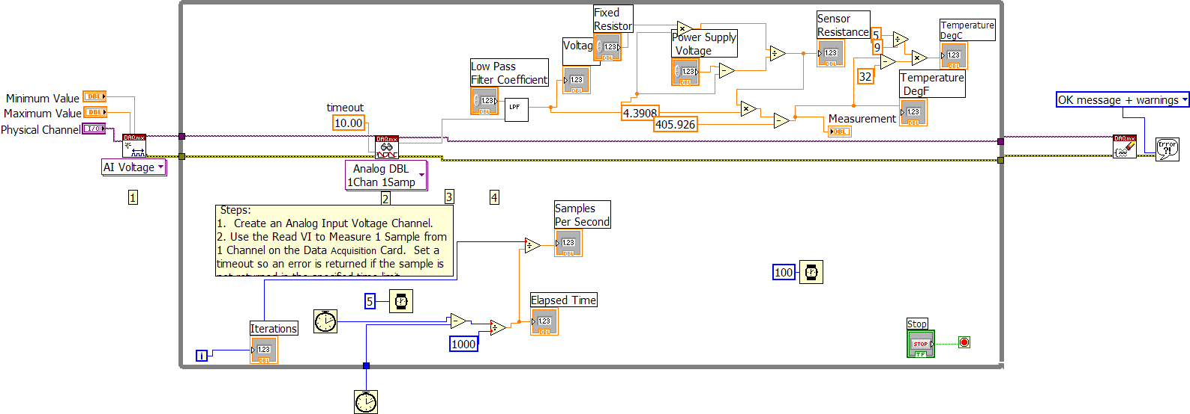
LabVIEW – Programming thru dataflow diagram
Temperature Measurement Example
Notes:
LabVIEW, a computer language develoepd by National Instruments, is actually based on data flow diagrams. This is an actual LabVIEW program for acquiring temperature data. Instead of specifing each step in chronological order, the flow of data is described and then LabVIEW figures out the order of instructions to make the data flow in the way specified.

Slide 18
State Diagrams
Often systems exist in different operating states
They transition rapidly between these states
These states are their transitions between the states can be shown in a state diagram
States are drawn as circles or bubbles
Transitions are indicated by arrows

Slide 19
State Diagram for a traffic light
Red
Flashing
Red
Loss of
Comm
State
Green
Power
Off
State
Off
Yellow

Slide 20
Shuttle Malfunction Procedures
It is possible to put procedures in the forms of flowcharts
The space shuttle malfunction procedures contain hundreds of flowcharts for troubleshooting anomalies with shuttle systems
The next page is an example of dealing with a cabin fan alarm
Cabin fan alarms are triggered by a delta pressure sensor which measure the difference in pressure on either side of the fan
Possible causes of the alarm are
  Failed sensor
  Failed fan
  Blockage in filter
  Blockage in line
  Leak in line
  Failed check valve

Slide 21
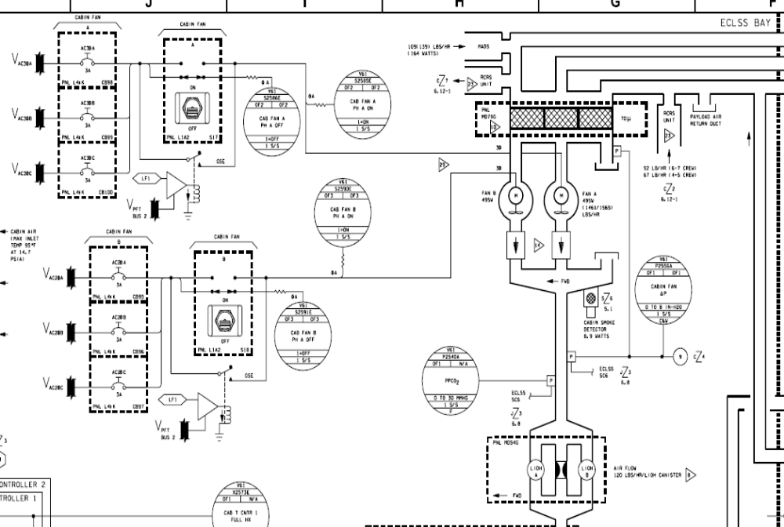
Cabin Fan Diagram From Shuttle Systems handbook

Slide 22
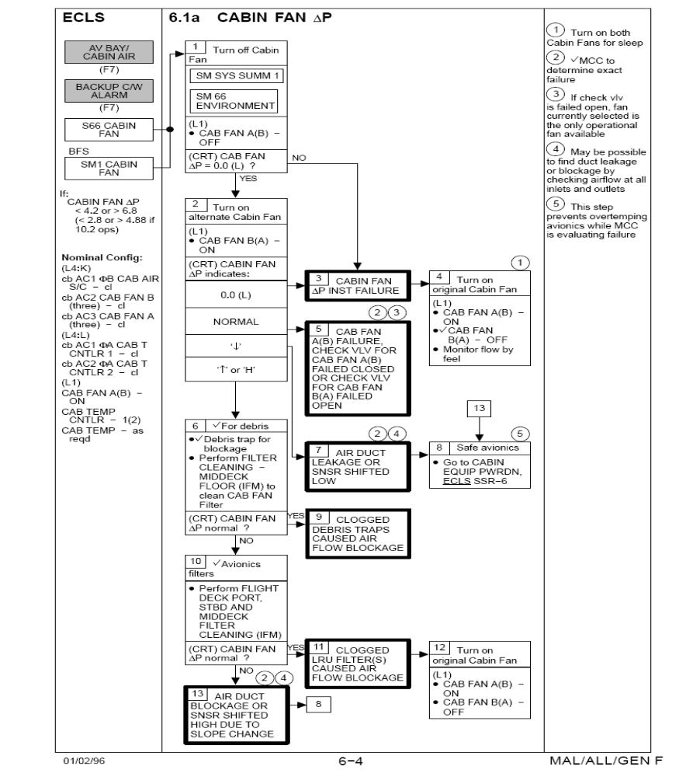
Shuttle
Cabin Fan
Malfunction
procedure

Slide 23
Decision Tree
A technique for evaluating options based on
  Expected likelihood of outcome
  Expected value of outcome
Typically done for economic value, can also be applied to other values such as weight
Build a tree to describe all possible outcomes
  Identify probability of reaching each outcome based on the probabilities at each branch of the tree
  Identify potential value (or cost) of each end state
Select option based on combination of likelihood and cost/value
  Can directly form a product of these two parameters
  Can screen by probability of outcome, cost or value
  Can screen by proximity of undesirable outcomes to desirable outcomes

Slide 24
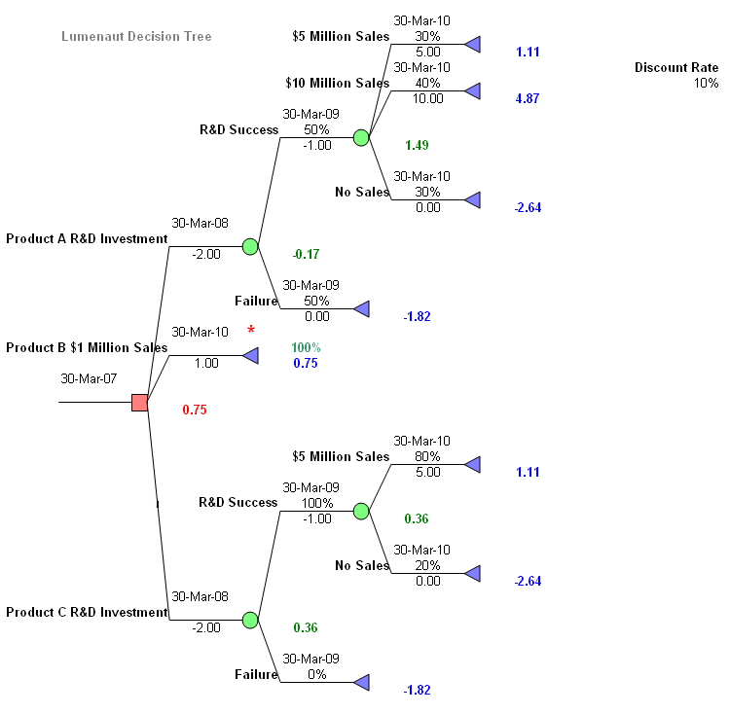
Example decision tree from Wikipedia

Slide 25
System Modeling Languages
There are several systems modeling languages
An example is Unified Modeling Language (UML) which allows expression of
  Relationships between items
  Behavior of items
    Activity diagram
    Case structure
    State machine diagram
  Interaction between items (flow of resources and information)
    Communication
    Sequencing
    Timing
UML diagrams show
  Functional requirements
  Static structure
  Dynamic behavior
SysML is a variant of UML that acts as a domain specific modeling language for systems engineering
  Adds requirement and parametric diagrams
  Adds functionality for automatic verification and validation and automated gap analysis
Their use, in DOD programs particularly, is growing and they are worth mentioning in our survey of flowcharting methodologies

